Slide 1
Accessibility
Michał Suliborski

Slide 2
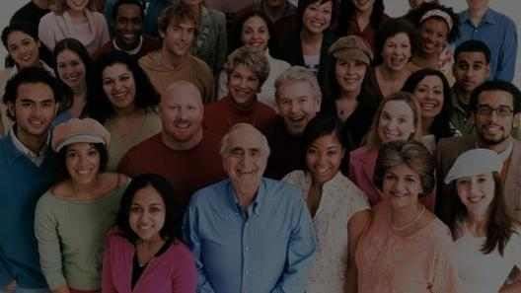
We are all different!

Slide 3
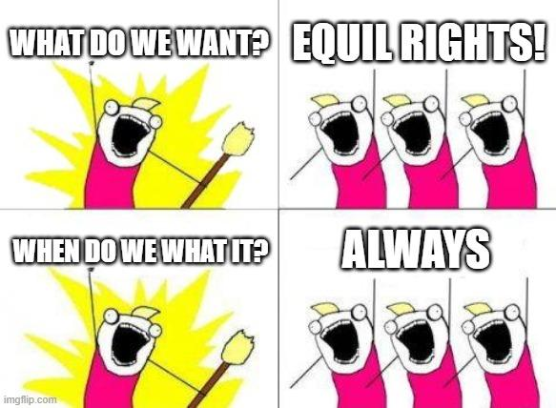

Slide 4
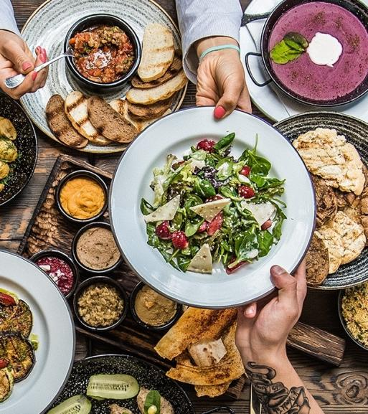


Slide 5


Slide 6



Slide 7
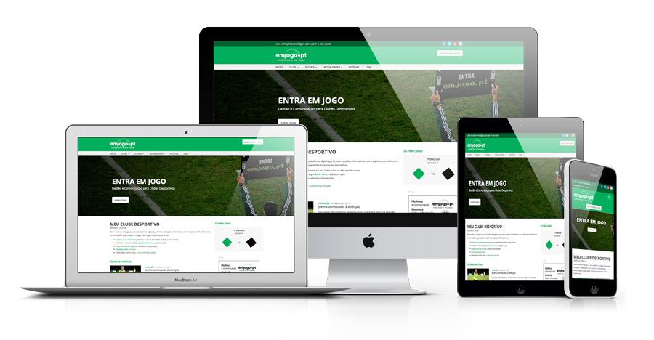

Slide 8
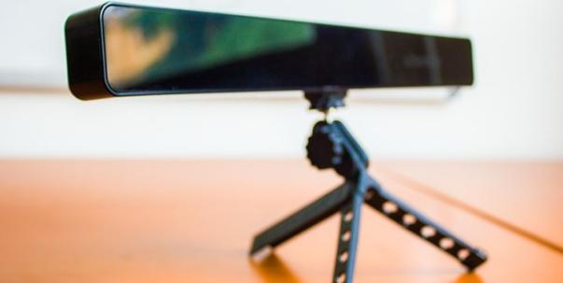
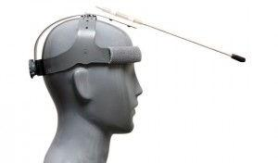
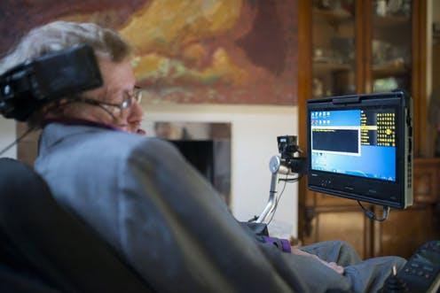
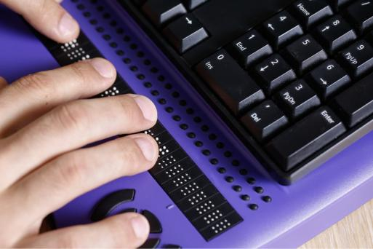

Slide 9
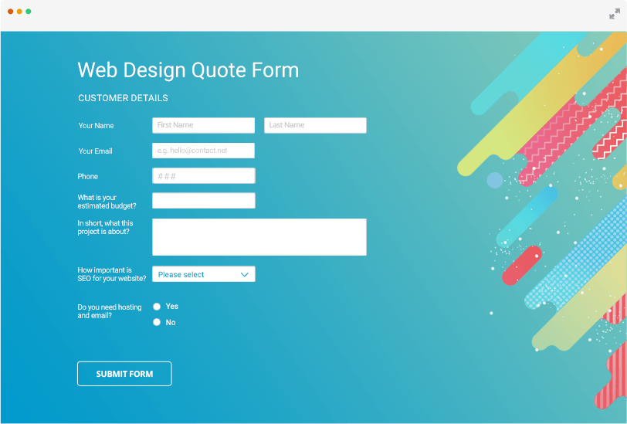
Forms for Users Using Assistive Technologies

Slide 10
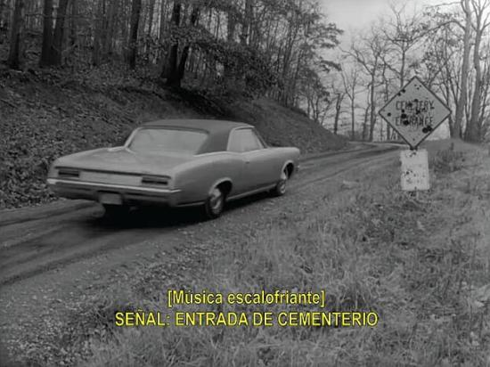
Synchronize Multimedia Elements

Slide 11
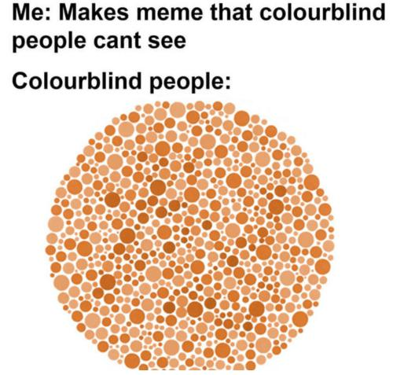

Slide 13
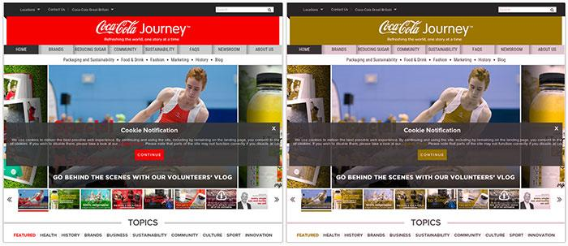
Do Not Use Colour Alone to Convey Information

Slide 14
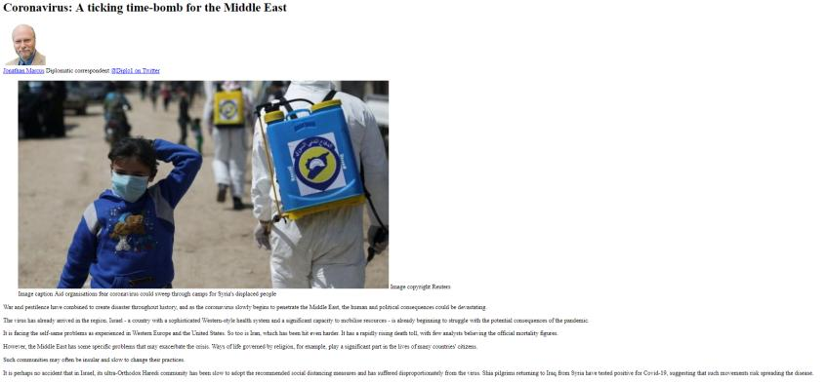
Designing websites not requiring stylesheet

Slide 15
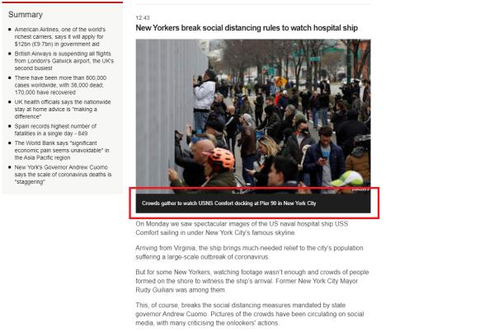
Provide Text Equivalents for Non-Text Elements

Slide 16


Slide 17
Thank you for your attention

